Slide 1
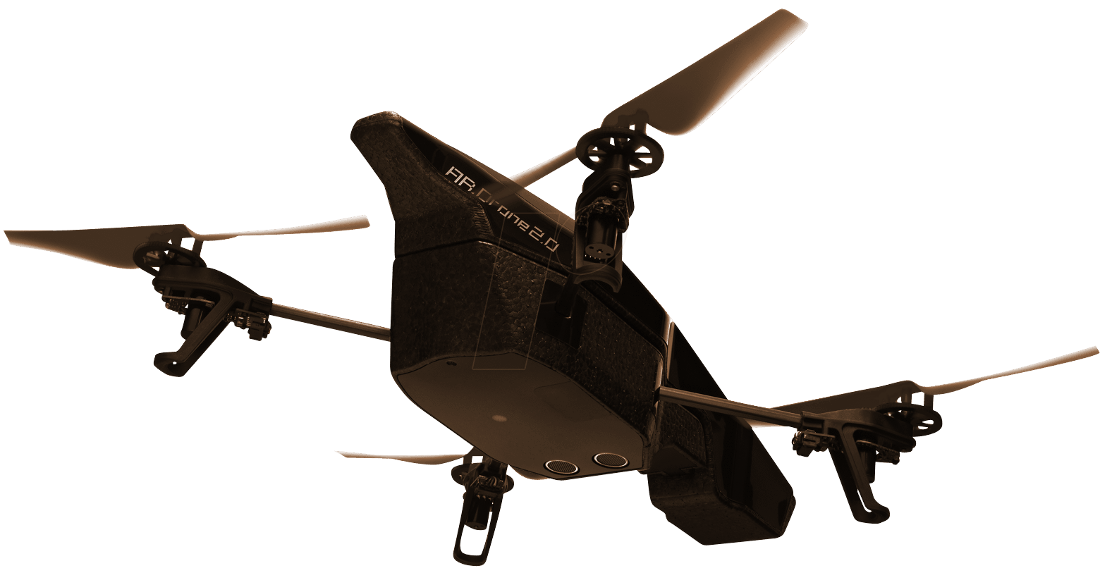

Senior Project Final Presentation
Fall 2016
FruiTREC v1.0
An Agricultural Robotics Application
Team Members: Product Owner: Mentor: Instructors: | Franklin Abodo, Gabriel Barrs, Miguel Chateloin Dr. Wagner Vendrame Dr. Leonardo Bobadilla Mohsen Taheri, Dr. Masoud Sadjadi
School of Computing and Information Sciences
Florida International University
Notes:
7 seconds.
Greet your audience, thank them for attending your presentation, introduce yourself, introduce your project, introduce your team members, and quickly indicate what each of you did in a high-level manner, and put more emphasis on your part/contribution.

Slide 2
Project definition
Crops used in agricultural research experiments today must be short and cover a small area.
One reason is because researchers must measure horticultural characteristics (HCs) by hand.
Crops may be too tall for humans to safely collect, or too broad for humans to conveniently collect, HC data.
Unmanned Aerial Vehicles (drones) can:
Increase coverage crops spanning large areas
Eliminate the risk of a person falling
Computer Vision (CV) tools can:
Automate the analysis of HC data
Notes:
20 seconds.
Introduce the problem that the your project (in new version) tackles with GIF or screenshot.

Slide 3
Project definition
The FruiTREC project requires the development of:
A mobile front-end that lets users plan and execute drone missions, and generate reports on collected HC data.
A CV module that extracts meaningful HC information from raw sensor data.
A website to allow additional users to access data visualizations on computers with large screens.
A back-end web application that interfaces the web and mobile clients, and the CV module and database.
Notes:
20 seconds.
Introduce the problem that the your project (in new version) tackles with GIF or screenshot.

Slide 4
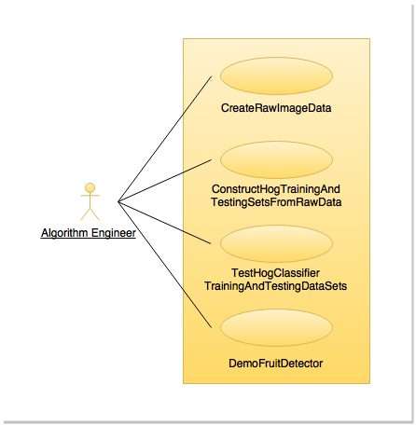
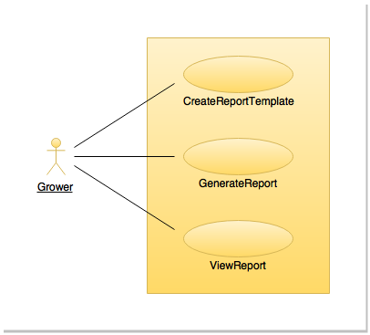
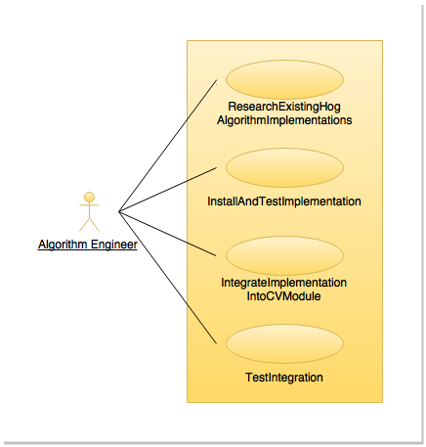
Requirements: Use Cases
Notes:
5 seconds
Show the Use Case Diagram for the whole project. Highlight your use cases.

Slide 5
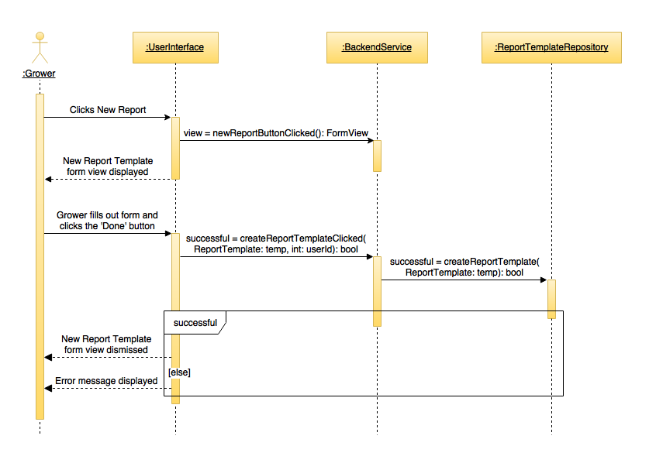
Requirements: Action Sequences
Notes:
5 seconds
Show the Use Case Diagram for the whole project. Highlight your use cases.

Slide 6
System Design
Notes:
20 seconds
System design: Highlight the parts that you contributed to them.
1. System decomposition; identify the architecture patterns used
2. System deployment – h/w and s/w requirements

Slide 7
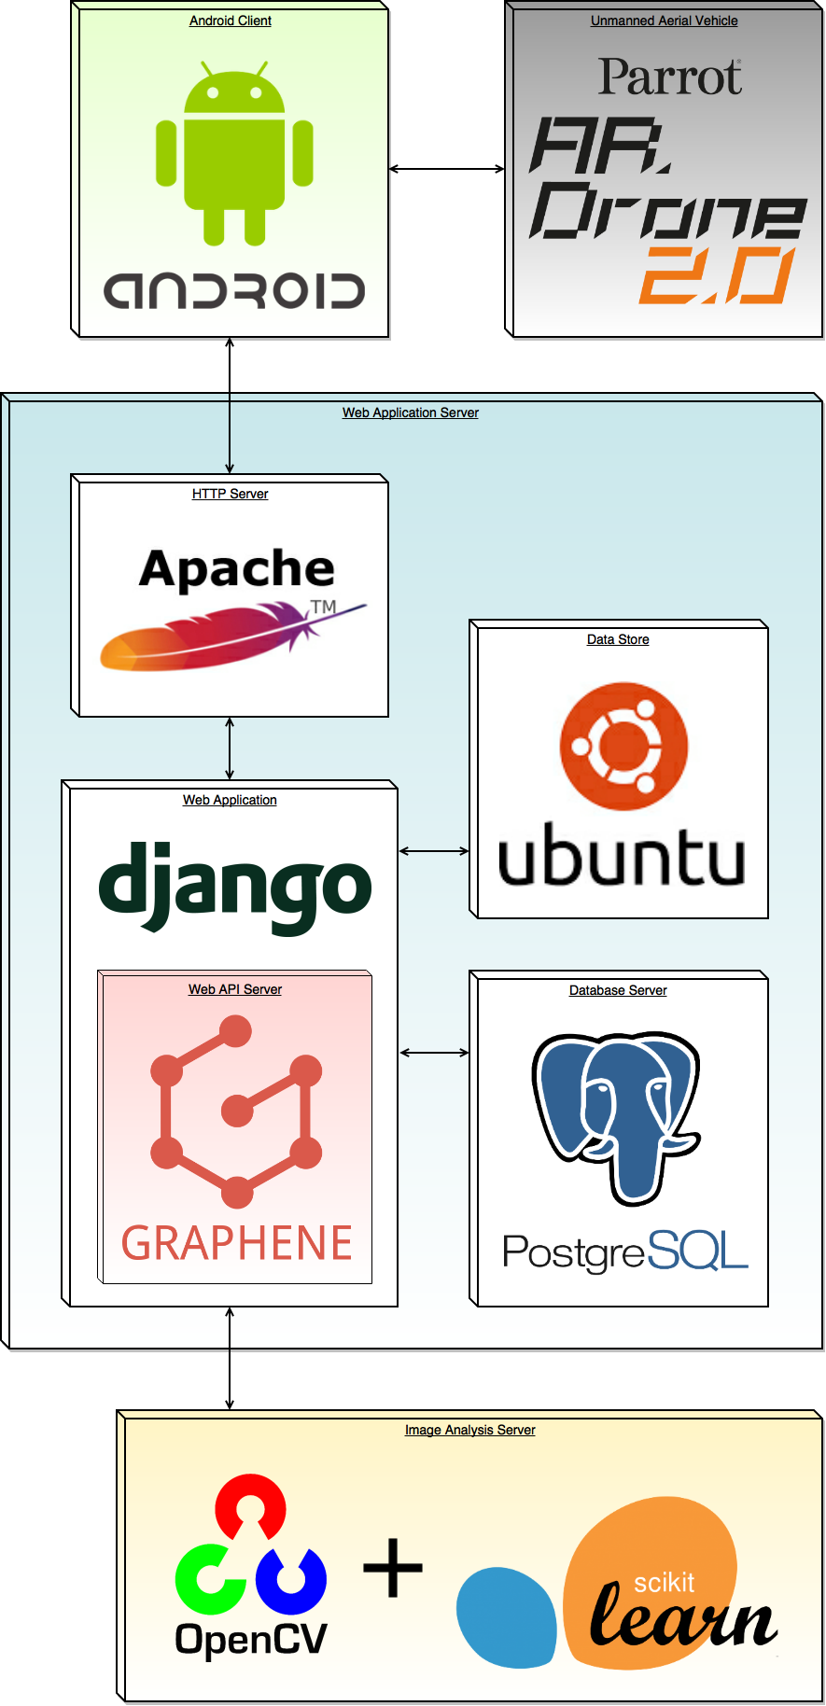
System Design: System Architecture Component Diagram
Each colored box (less the pink one) represents one hardware component of the system.
Notes:
20 seconds
System design: Highlight the parts that you contributed to them.
1. System decomposition; identify the architecture patterns used
2. System deployment – h/w and s/w requirements

Slide 8
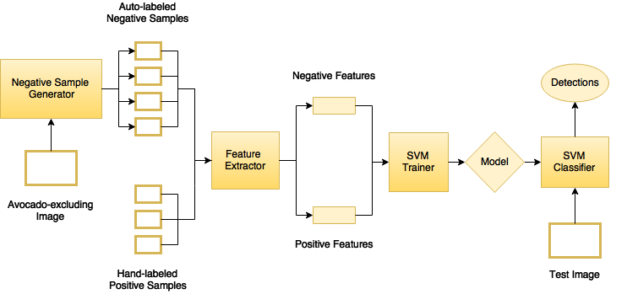
System Design: Fruit Detector Component Diagram
Notes:
20 seconds
System design: Highlight the parts that you contributed to them.
1. System decomposition; identify the architecture patterns used
2. System deployment – h/w and s/w requirements

Slide 9
User Stories
#130 — NavData Service Module
#202 — Design and Implement Data Model for Drone Mission Data
#223 — Drone Control Service
#180 — Design A Segmentation Pipeline for Brown Sapoti
#179 — Design A Segmentation Pipeline for Longan
#213 — Implement the HOG Object Detection Algorithm in Python
#240 — Create a Longan Fruit Detector using the HOG Algorithm
Notes:
20 seconds
The tile of user story
Please present and show the complexity of your work, code, algorithms, and technical challenges and technologies you have used. (you could use screenshot if you want. Visual presentations are better than text presentation) - Go into the details of the most important/significant tasks using bullet lists or visual graphs or state chart diagram - Demo using screenshots or GIF (in another separate page if required)
Sequence Diagram for this user story is optional

Slide 10
User Story #130 — NavData Service Module
Description: As a developer, I would like read access to live drone navdata, such as altitude and GPS coordinates, so that I can use that information to make business logic decisions.
Acceptance Criteria:
Must provide at least: attitude, altitude, gps, battery, accelero, gyroscope, magnetometer and fly state
All navdata should all be real-time, no caching.
Notes:
20 seconds
The tile of user story
Please present and show the complexity of your work, code, algorithms, and technical challenges and technologies you have used. (you could use screenshot if you want. Visual presentations are better than text presentation) - Go into the details of the most important/significant tasks using bullet lists or visual graphs or state chart diagram - Demo using screenshots or GIF (in another separate page if required)
Sequence Diagram for this user story is optional

Slide 11
User Story #223 — Drone Control Service
Description:
As a developer, I would like to have the ability to send command through the drone via a module that abstracts the details of the network layer to the business logic.
Acceptance Criteria:
Must expose following 5 AT command set of the AR Drone: AT*REF, AT*PCD_MAG, AT*_FTRIM, AT*CALIB, AT*CONFIG
Must send an AT Command to stall if no input received for more than 1500 milliseconds in order to not lose collection with the drone.
Notes:
20 seconds
The tile of user story
Please present and show the complexity of your work, code, algorithms, and technical challenges and technologies you have used. (you could use screenshot if you want. Visual presentations are better than text presentation) - Go into the details of the most important/significant tasks using bullet lists or visual graphs or state chart diagram - Demo using screenshots or GIF (in another separate page if required)
Sequence Diagram for this user story is optional

Slide 12
User Story #202 — Design and Implement Data Model for Drone Mission Data
Description:
As a backend developer I would like to create a data model for all drone mission data (position, attitude, etc.) to serve as the basis of the Python classes that psycopg2 (an object-relational mapper) will map to entities, attributes, and relations in postgres.
Notes:
20 seconds
The tile of user story
Please present and show the complexity of your work, code, algorithms, and technical challenges and technologies you have used. (you could use screenshot if you want. Visual presentations are better than text presentation) - Go into the details of the most important/significant tasks using bullet lists or visual graphs or state chart diagram - Demo using screenshots or GIF (in another separate page if required)
Sequence Diagram for this user story is optional

Slide 13
User Story #180 — Design A Segmentation Workflow/Pipeline for Brown Sapoti Trees
Description:
Use any combination of filters and algorithms learned from the six texts in the research material collection to isolate brown sapoti fruits from image background objects.
Demonstrate the efficacy of the process by comparing the output to some hand-crafted ground truth.
Notes:
20 seconds
The tile of user story
Please present and show the complexity of your work, code, algorithms, and technical challenges and technologies you have used. (you could use screenshot if you want. Visual presentations are better than text presentation) - Go into the details of the most important/significant tasks using bullet lists or visual graphs or state chart diagram - Demo using screenshots or GIF (in another separate page if required)
Sequence Diagram for this user story is optional

Slide 14
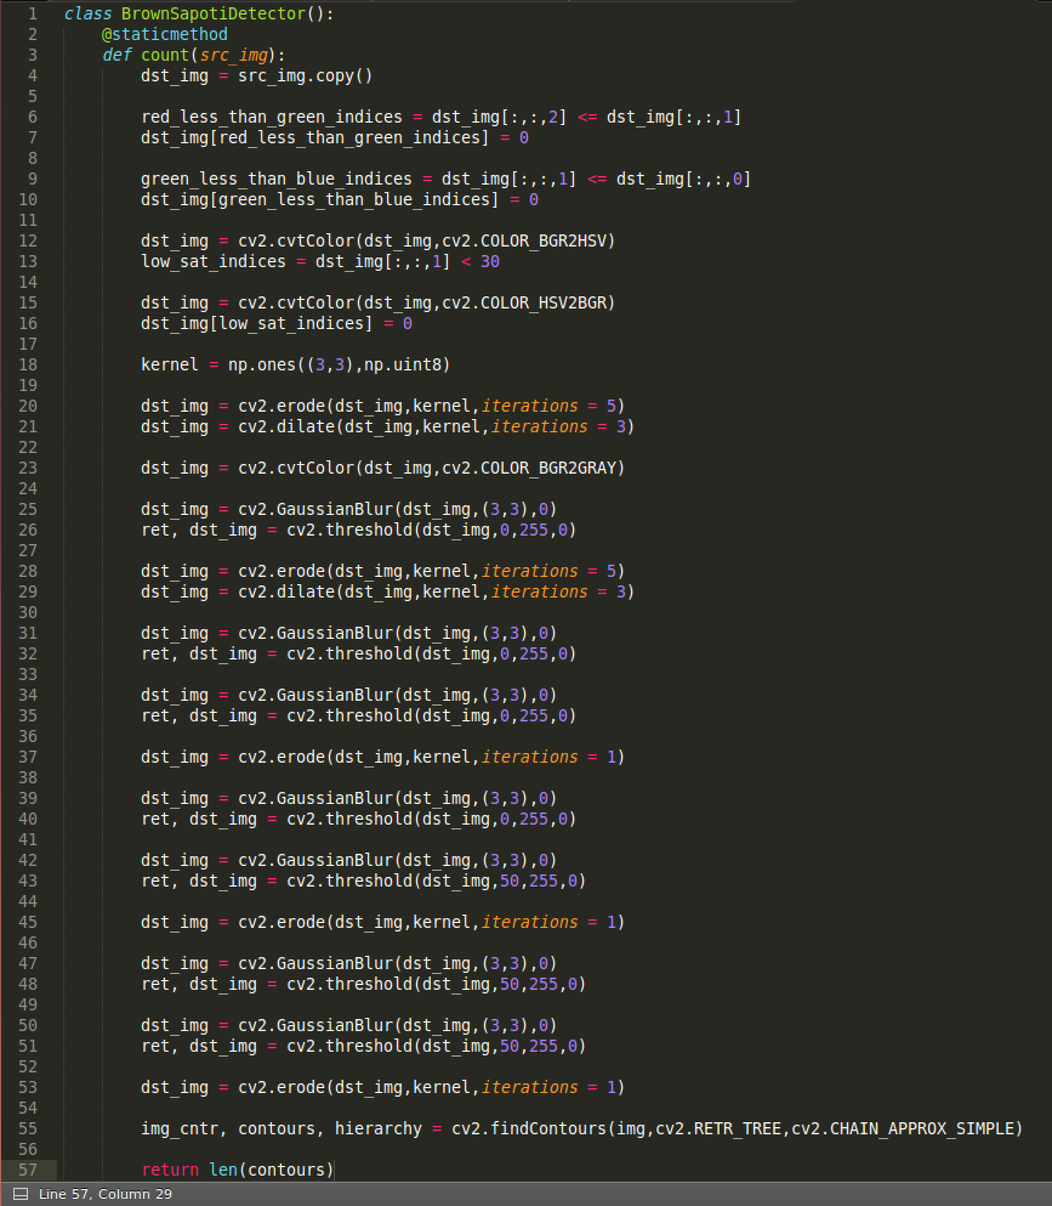
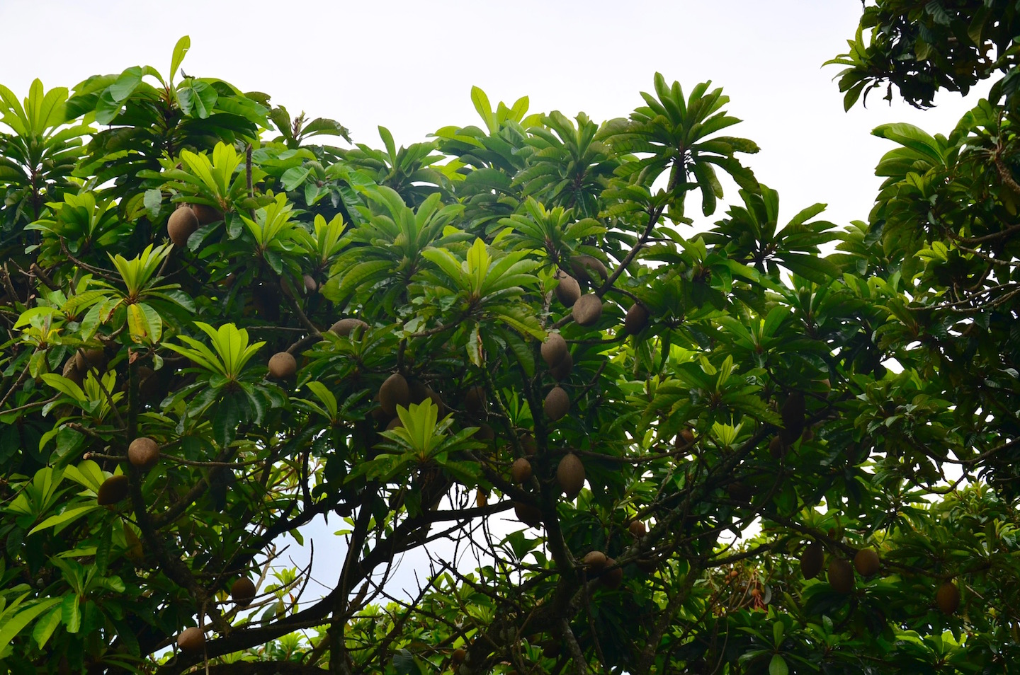
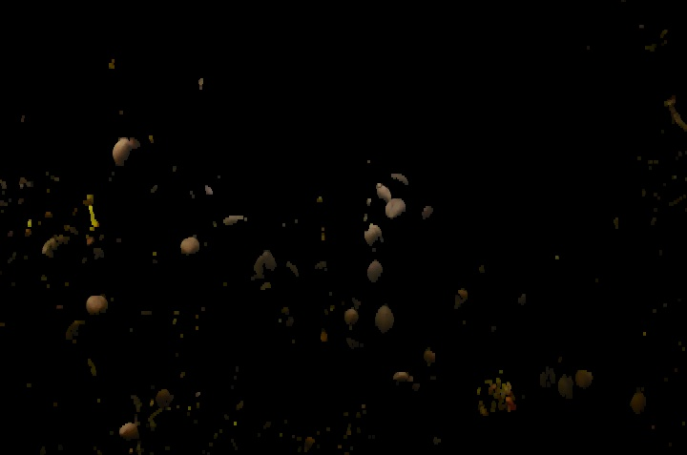
User Story #180 — Design A Segmentation Workflow/Pipeline for Brown Sapoti Trees
Notes:
20 seconds
The tile of user story
Please present and show the complexity of your work, code, algorithms, and technical challenges and technologies you have used. (you could use screenshot if you want. Visual presentations are better than text presentation) - Go into the details of the most important/significant tasks using bullet lists or visual graphs or state chart diagram - Demo using screenshots or GIF (in another separate page if required)
Sequence Diagram for this user story is optional

Slide 15
User Story #179 — Design A Segmentation Workflow/Pipeline for Longan Trees
Description:
Use any combination of filters and algorithms learned from the six texts in the research material collection to isolate longan fruits from image background objects.
Demonstrate the efficacy of the process by comparing the output to some hand-crafted ground truth.
Notes:
20 seconds
The tile of user story
Please present and show the complexity of your work, code, algorithms, and technical challenges and technologies you have used. (you could use screenshot if you want. Visual presentations are better than text presentation) - Go into the details of the most important/significant tasks using bullet lists or visual graphs or state chart diagram - Demo using screenshots or GIF (in another separate page if required)
Sequence Diagram for this user story is optional

Slide 16
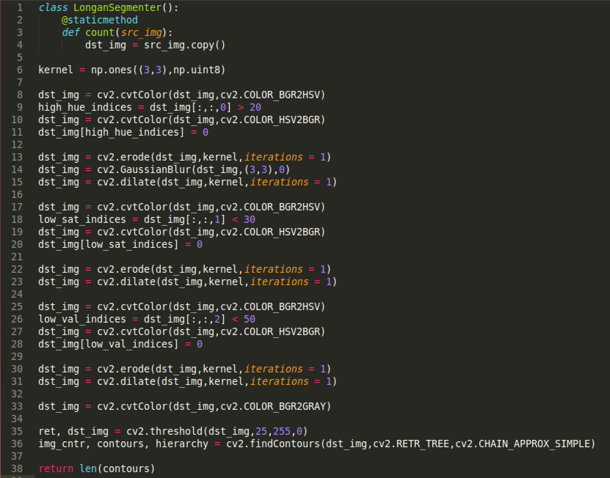
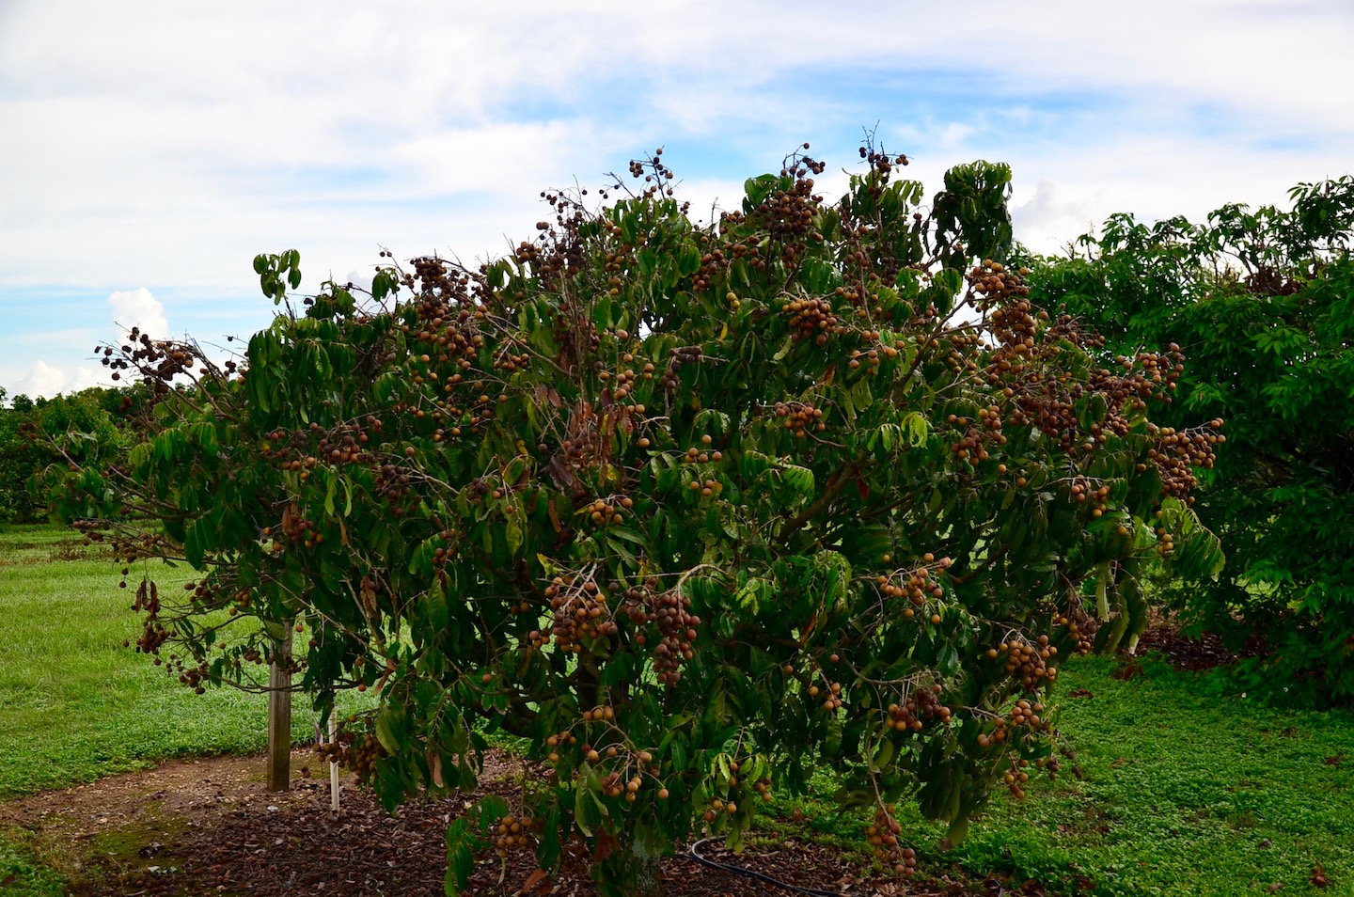
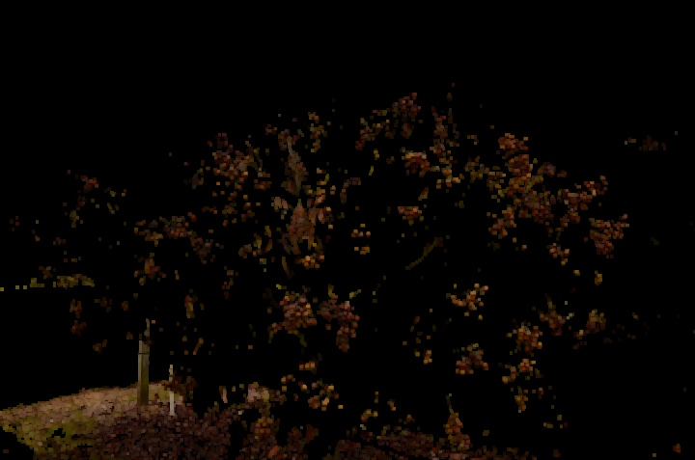
User Story #179 — Design A Segmentation Workflow/Pipeline for Longan Trees
Notes:
20 seconds
The tile of user story
Please present and show the complexity of your work, code, algorithms, and technical challenges and technologies you have used. (you could use screenshot if you want. Visual presentations are better than text presentation) - Go into the details of the most important/significant tasks using bullet lists or visual graphs or state chart diagram - Demo using screenshots or GIF (in another separate page if required)
Sequence Diagram for this user story is optional

Slide 17
User Story #213 — Implement the HOG Object Detection Algorithm in Python
Description:
As a developer, I want to implement a texture-based object detection algorithm to count fruits that are similar in color to their surroundings.
Work Log:
We adapted Bikramjot Hanzra’s implementation of the HOG algorithm and added utilities for SVM classifier’s data set construction:
Notes:
20 seconds
The tile of user story
Please present and show the complexity of your work, code, algorithms, and technical challenges and technologies you have used. (you could use screenshot if you want. Visual presentations are better than text presentation) - Go into the details of the most important/significant tasks using bullet lists or visual graphs or state chart diagram - Demo using screenshots or GIF (in another separate page if required)
Sequence Diagram for this user story is optional

Slide 18
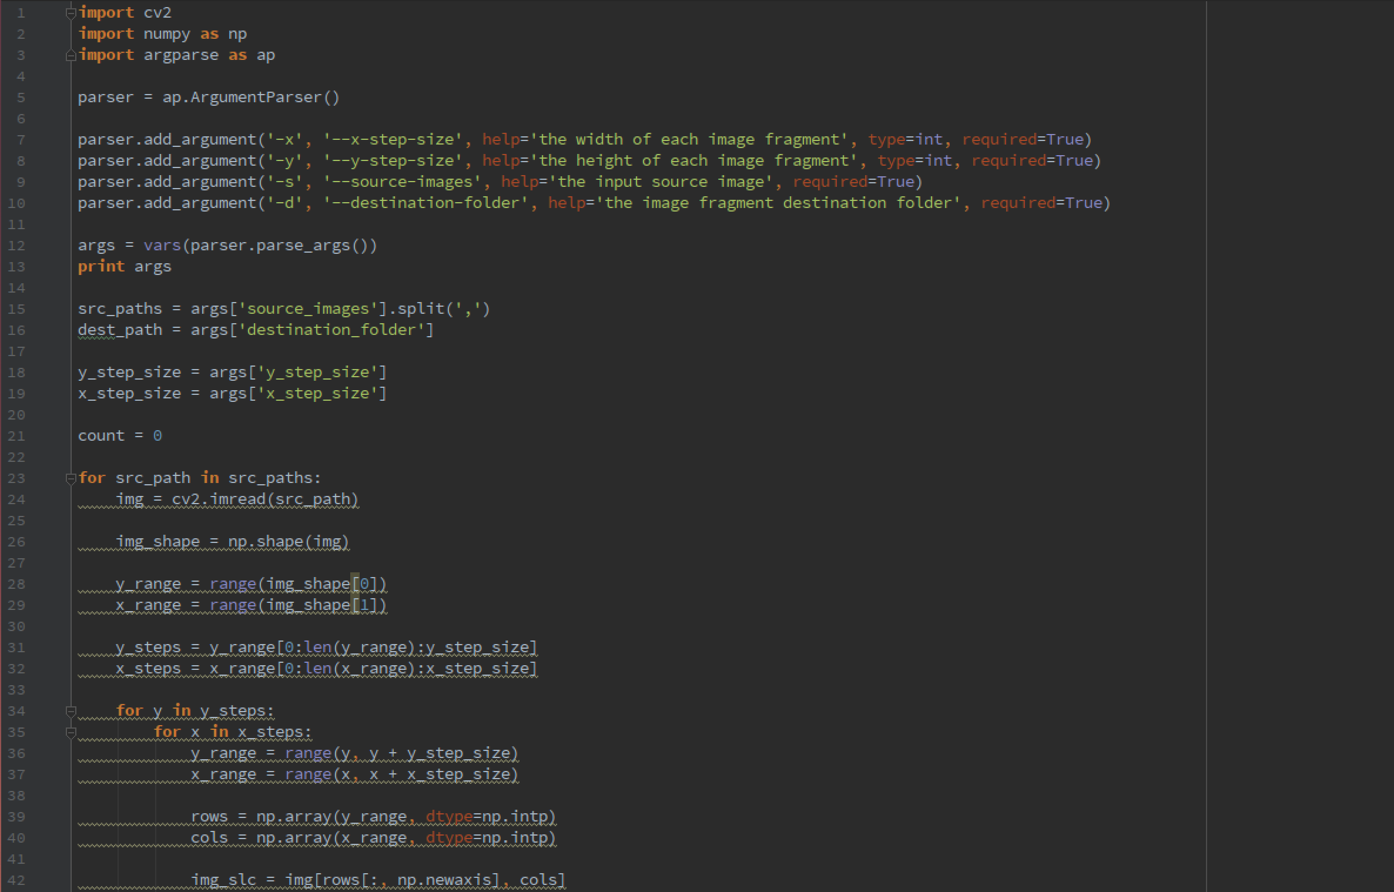
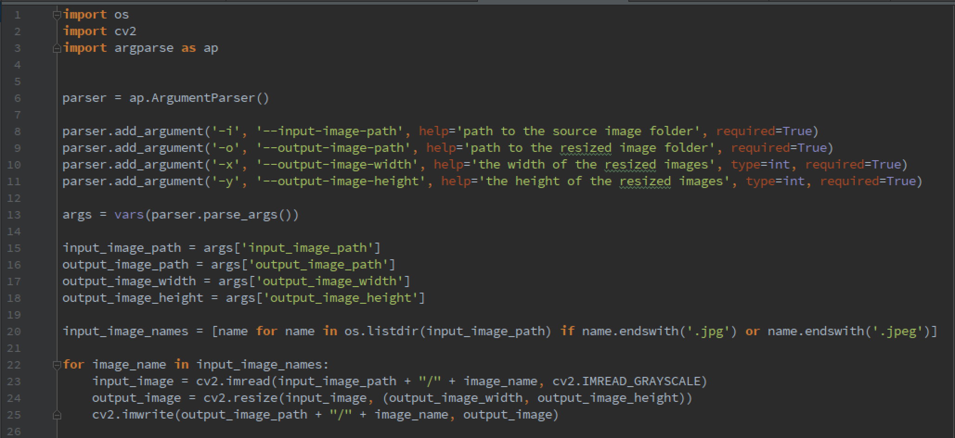
User Story #213 — Implement the HOG Object Detection Algorithm in Python
Notes:
20 seconds
The tile of user story
Please present and show the complexity of your work, code, algorithms, and technical challenges and technologies you have used. (you could use screenshot if you want. Visual presentations are better than text presentation) - Go into the details of the most important/significant tasks using bullet lists or visual graphs or state chart diagram - Demo using screenshots or GIF (in another separate page if required)
Sequence Diagram for this user story is optional

Slide 19
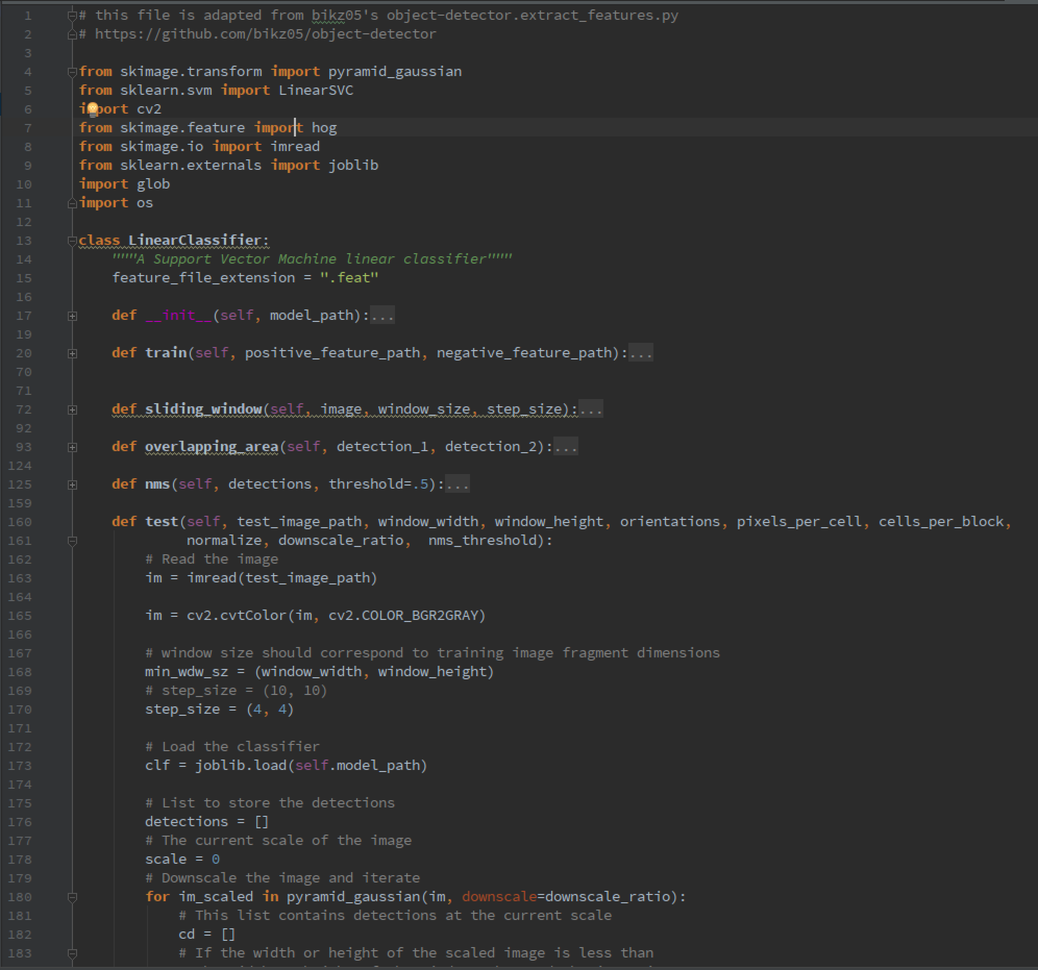
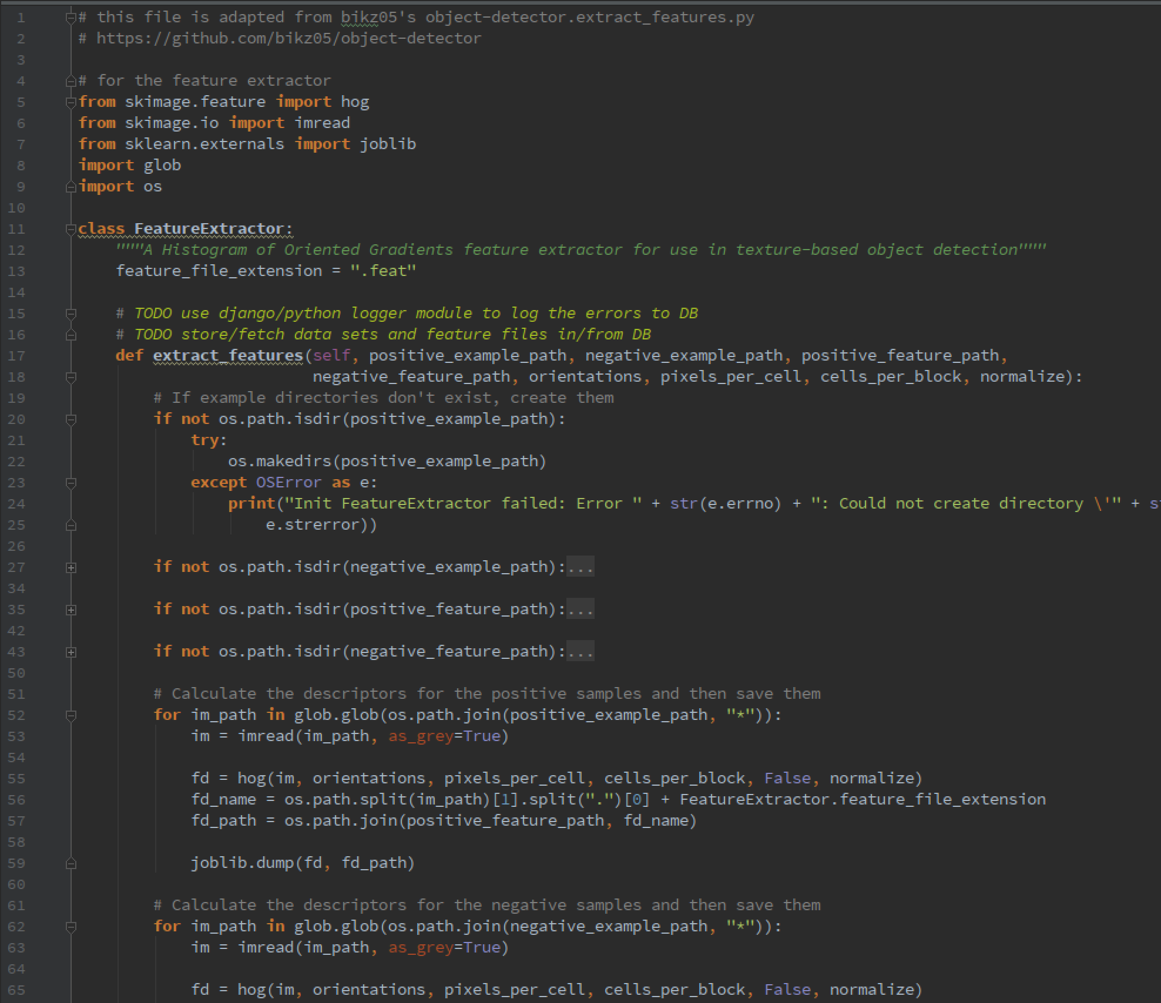
User Story #213 — Implement the HOG Object Detection Algorithm in Python
Notes:
20 seconds
The tile of user story
Please present and show the complexity of your work, code, algorithms, and technical challenges and technologies you have used. (you could use screenshot if you want. Visual presentations are better than text presentation) - Go into the details of the most important/significant tasks using bullet lists or visual graphs or state chart diagram - Demo using screenshots or GIF (in another separate page if required)
Sequence Diagram for this user story is optional

Slide 20
User Story #240 — Create a Longan Fruit Detector using the HoG Algorithm
Description:
As an algorithm engineer, I want to create a longan fruit detector using the texture-based HOG method because the color-based method previously implemented was not effective.
Acceptance Criteria:
80% detection accuracy (average for machine learning algs)
Notes:
20 seconds
The tile of user story
Please present and show the complexity of your work, code, algorithms, and technical challenges and technologies you have used. (you could use screenshot if you want. Visual presentations are better than text presentation) - Go into the details of the most important/significant tasks using bullet lists or visual graphs or state chart diagram - Demo using screenshots or GIF (in another separate page if required)
Sequence Diagram for this user story is optional

Slide 21
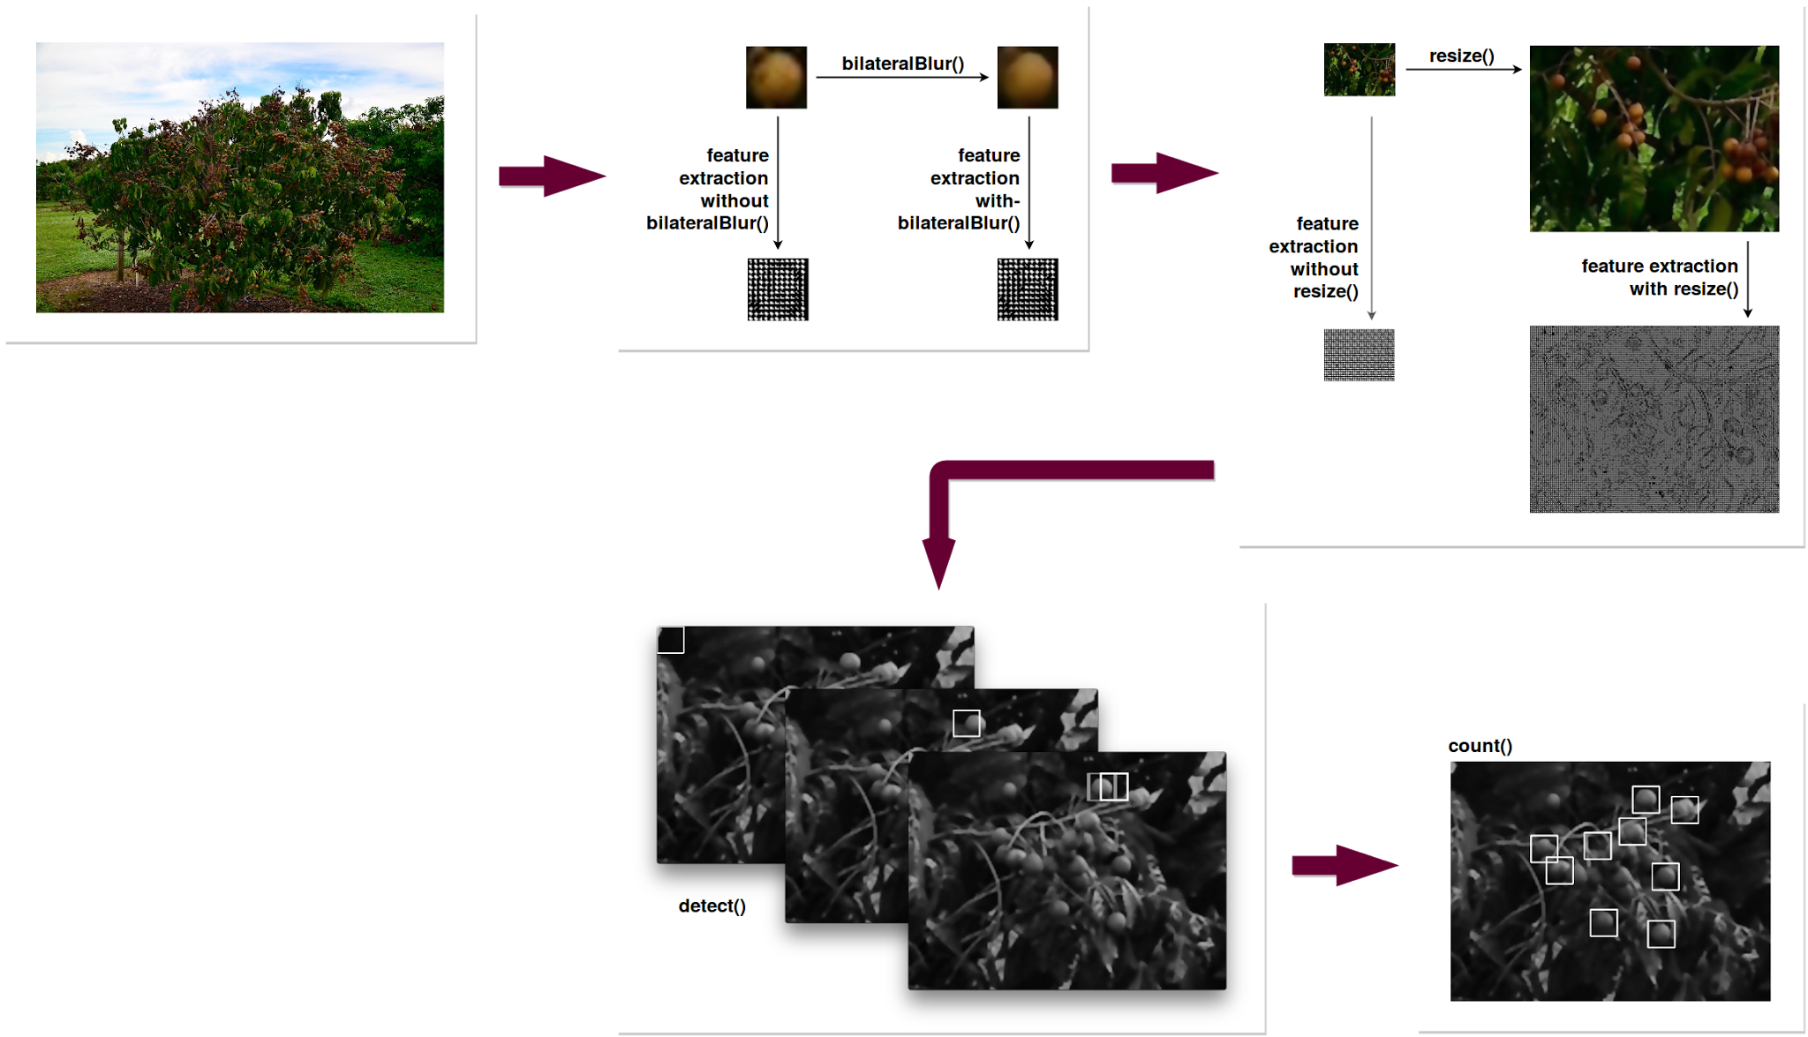
User Story #240 — Create a Longan Fruit Detector using the HoG Algorithm
Notes:
20 seconds
The tile of user story
Please present and show the complexity of your work, code, algorithms, and technical challenges and technologies you have used. (you could use screenshot if you want. Visual presentations are better than text presentation) - Go into the details of the most important/significant tasks using bullet lists or visual graphs or state chart diagram - Demo using screenshots or GIF (in another separate page if required)
Sequence Diagram for this user story is optional

Slide 22
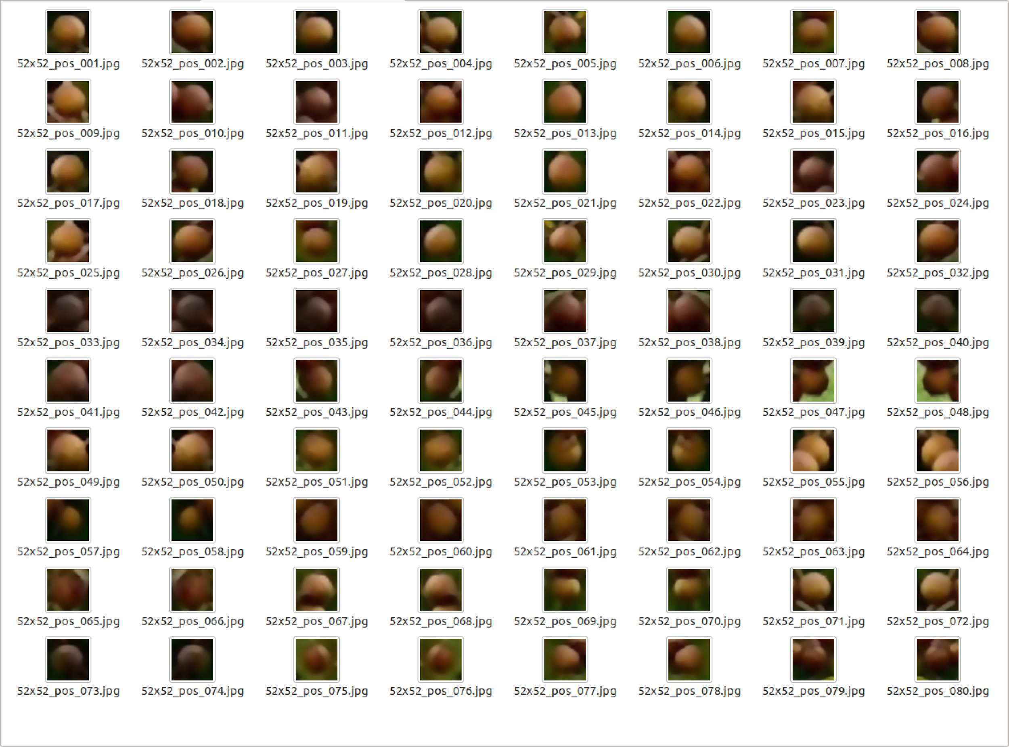
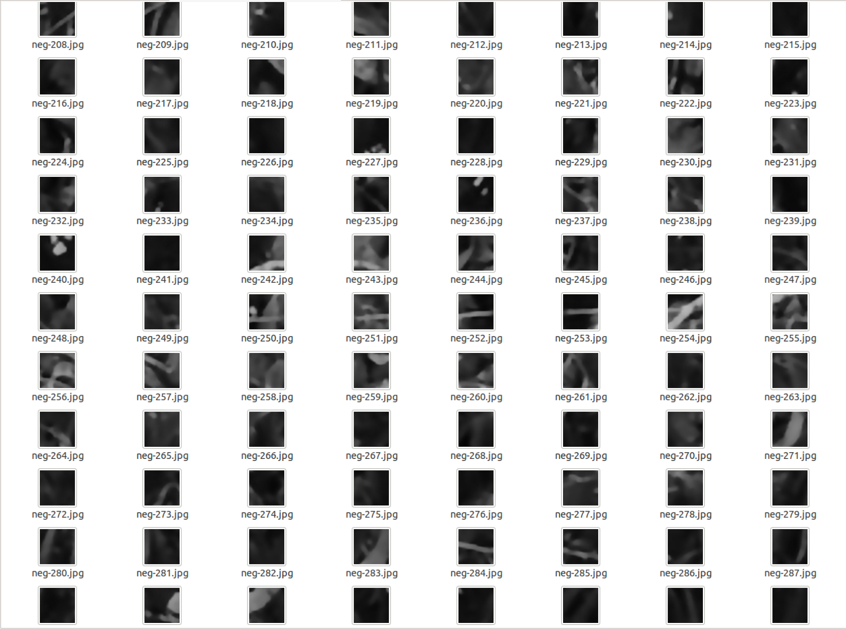
User Story #240, Task #242 — Create Training/Test Data for Longan Detector
Notes:
20 seconds
The tile of user story
Please present and show the complexity of your work, code, algorithms, and technical challenges and technologies you have used. (you could use screenshot if you want. Visual presentations are better than text presentation) - Go into the details of the most important/significant tasks using bullet lists or visual graphs or state chart diagram - Demo using screenshots or GIF (in another separate page if required)
Sequence Diagram for this user story is optional

Slide 23
Class Diagrams
Notes:
20 seconds
The tile of user story
Please present and show the complexity of your work, code, algorithms, and technical challenges and technologies you have used. (you could use screenshot if you want. Visual presentations are better than text presentation) - Go into the details of the most important/significant tasks using bullet lists or visual graphs or state chart diagram - Demo using screenshots or GIF (in another separate page if required)
Sequence Diagram for this user story is optional

Slide 24
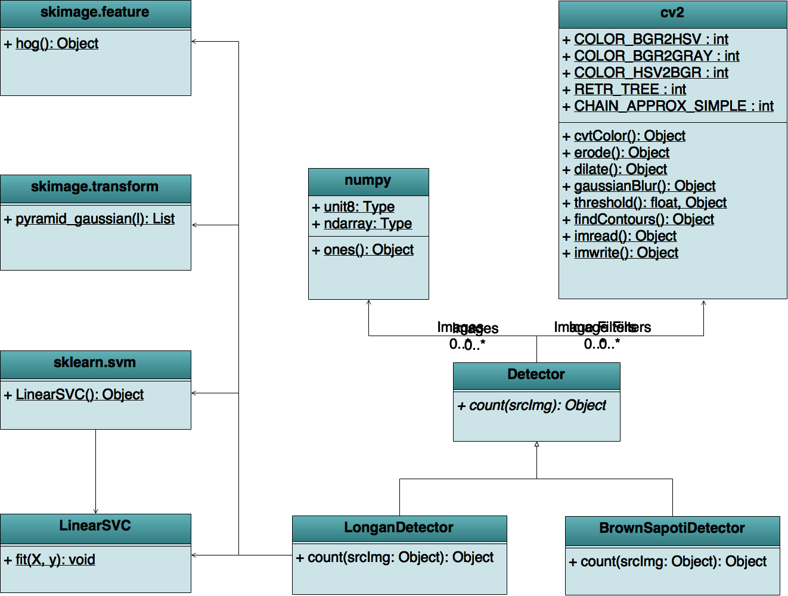
Class Diagram: Image Analysis Subsystem
Notes:
20 seconds
The tile of user story
Please present and show the complexity of your work, code, algorithms, and technical challenges and technologies you have used. (you could use screenshot if you want. Visual presentations are better than text presentation) - Go into the details of the most important/significant tasks using bullet lists or visual graphs or state chart diagram - Demo using screenshots or GIF (in another separate page if required)
Sequence Diagram for this user story is optional

Slide 25
Test Suites and Test Cases
Notes:
10 seconds
A description of verification process and Test Suites and Test Cases for one of the use cases.
1 One sunny day and one rainy day for the implemented use cases (one or more slides).
2 Automated test scripts for the implemented use cases (if any) (one or more slides).

Slide 26




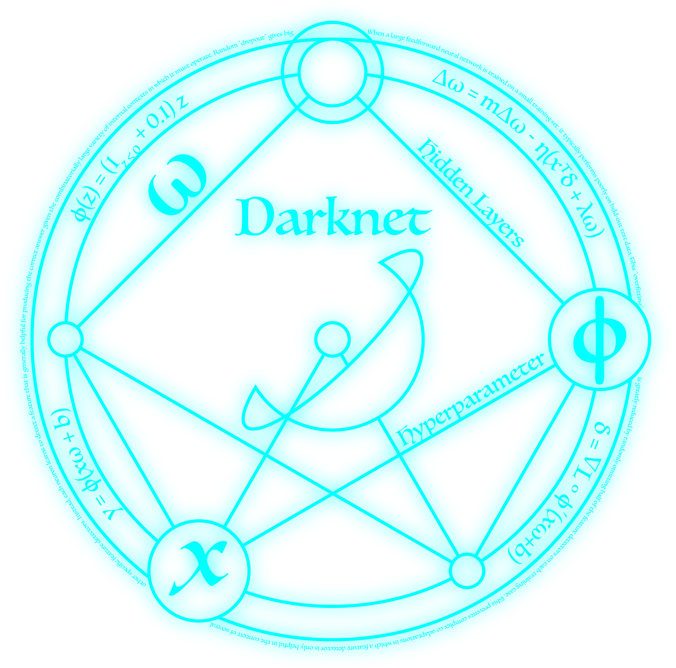








Summary
FruiTREC is:
Summary
contact information
Questions?
Thank You!
Notes:
10 seconds
Summarize your contribution, mention your effort for Scrum, Mingle, Github, Google Drive Documentation and minutes
Include your contact information
Ask if anyone has any questions for you.
Thank your audience

Slide 27
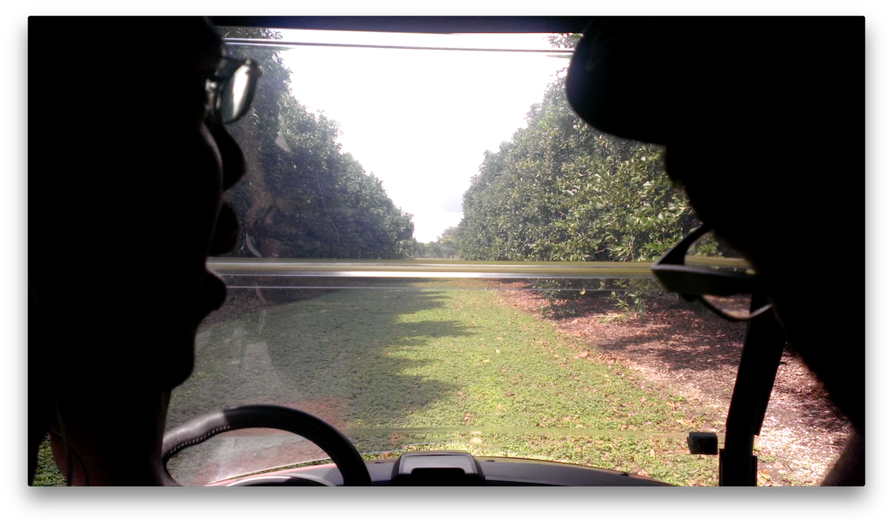
We are:
Franklin Abodo, Gabriel Barrs, Miguel Chateloin
{ fabod001, gbarr016, mchat003 }@fiu.edu
Notes:
10 seconds
A description of verification process and Test Suites and Test Cases for one of the use cases.
1 One sunny day and one rainy day for the implemented use cases (one or more slides).
2 Automated test scripts for the implemented use cases (if any) (one or more slides).

